Slide 1
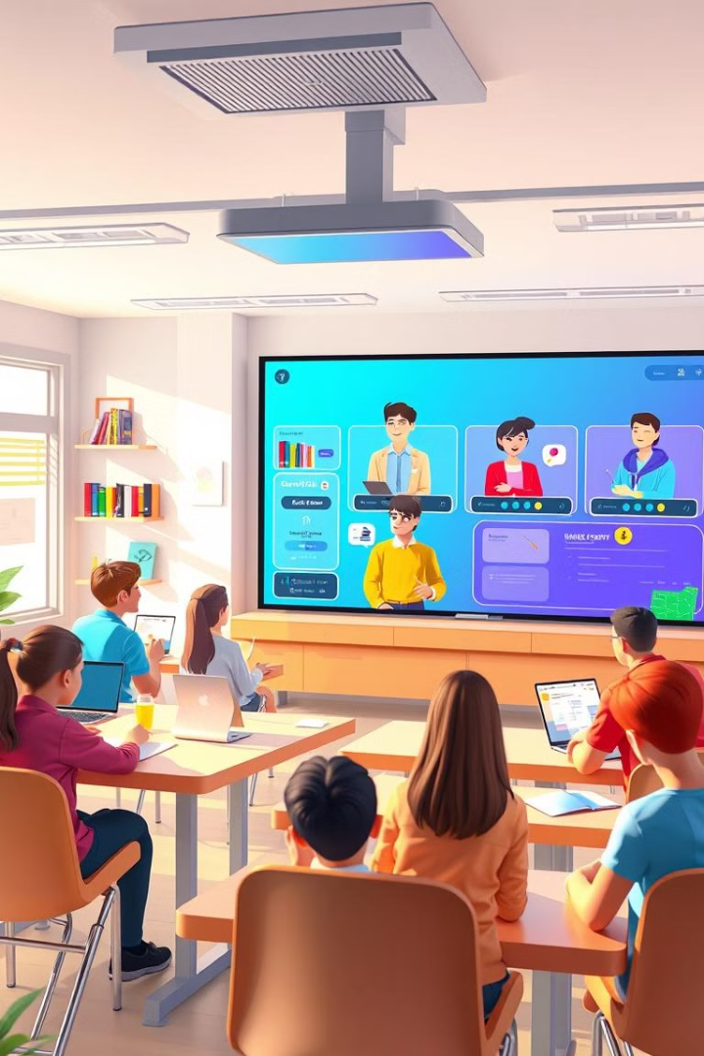

LearnBridge: Revolutionising Online Education
LearnBridge is a feature-rich, scalable online learning platform. It redefines education by providing an interactive and accessible digital environment. Built using the MERN stack, it caters to students, teachers, and administrators.

Slide 2


Team Members
Khadija Imran
Muhammad Asif
(2022-CS-171)
(2022-CS-179)
Shahbaz Ali
(2022R2019-CS-147)

Slide 3

Empowering Education
Online
Students
Teachers
Easy access to resources anytime, anywhere. Personalized learning experiences.
Tools to create, manage, and deliver courses. Efficient progress tracking.
Administrators
Streamlined workflows for user approvals and platform monitoring.

Slide 4




Core Functionalities
User Authentication
Custom Dashboards
Secure, role-based login for students, teachers, and admins.
Role-specific dashboards displaying relevant data and actions.
Interactive Tools
Video conferencing and in-app messaging for seamless communication.

Slide 5

Course Management and Purchase
Course Catalogs
Secure Payments
Platform Scalability
Browse, buy, and access courses easily.
Hassle-free transactions via secure payment gateways.
Modular architecture to support increasing user demands.

Slide 6





Development Methodology
Requirement Analysis
Gather and document requirements from stakeholders.
Design
Create wireframes and prototypes using Figma.
Development
Frontend: React with Vite. Backend: Node.js and Express.
Testing and Feedback
Rigorous unit and integration testing.

Slide 7
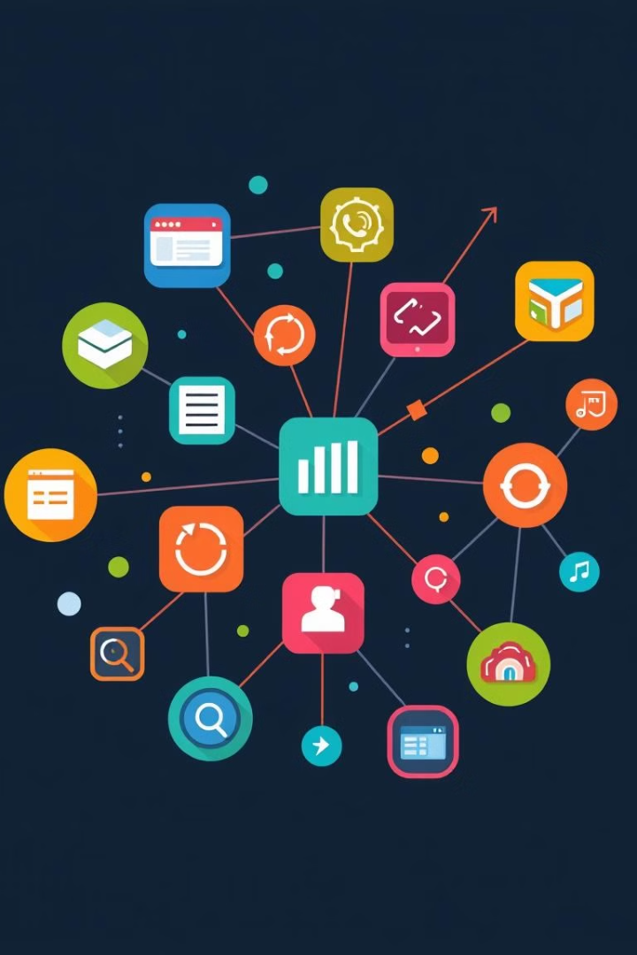



Key Features and Functionality
User Authentication
Custom Dashboards
Course Purchase
Intuitive catalog and secure payment options.
Separate login portals for each role.
Role-based access to relevant features.

Slide 8
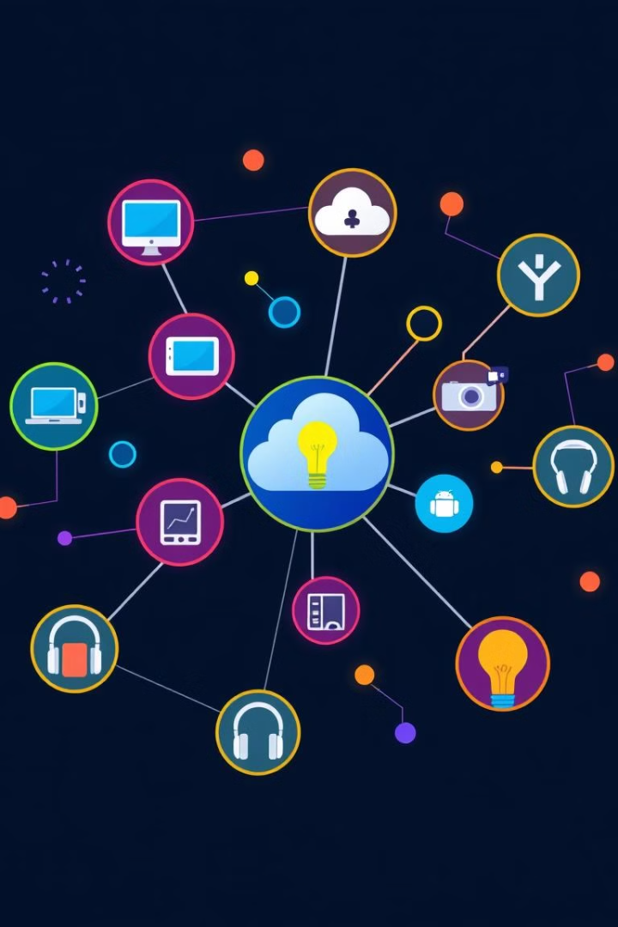
Technologies and Tools
UI/UX Design
Figma, Dribble
Frontend
React, Vite, Axios, Redux
Backend
Node.js, Express, Mongoose
Database
MongoDB
Payment
Razorpay

Slide 9
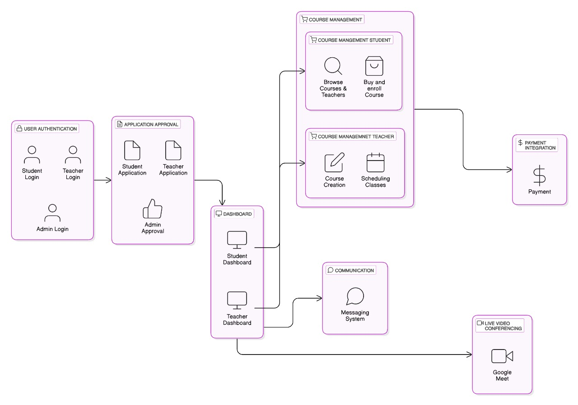
Diagram

Slide 10




Conclusion
Unified Platform
Secure Operations
Scalable Solution
For students, teachers, and administrators.
Robust authentication and payment systems.
Ready for future enhancements.
Future: AI for personalized learning and advanced analytics.

Slide 11
Thanks!!!

